Slide 1
Signal analysis voice dataset
Prepared by
Tasnim Nishat islam
1706092

Slide 2
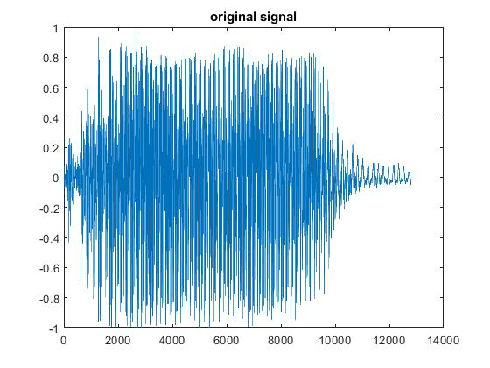
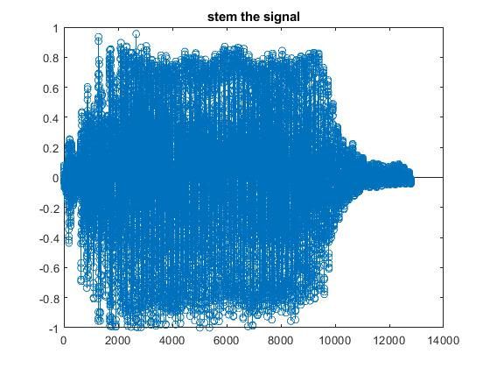
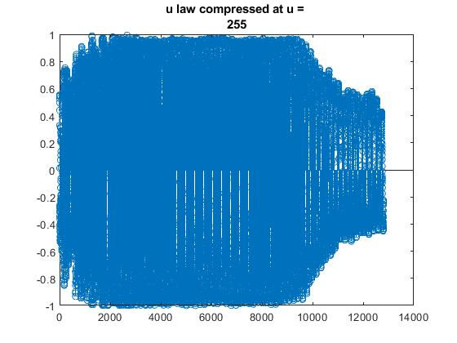
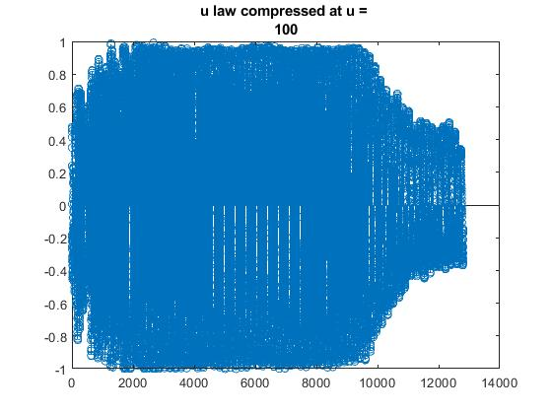
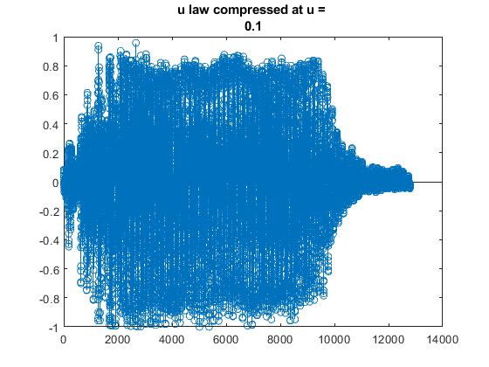
Change of sample rate observation
Sample rate = 44100
If sample rate 25000, the sound can be first heard
The sound goes from deep to narrow(male to female to child range)
Original Signal and discrete signal
U law compressor
The last part is basically silence, where the peaks are low, here I want to eliminate these, for this purpose if u law can suppress the values more, that is the goal

Slide 3
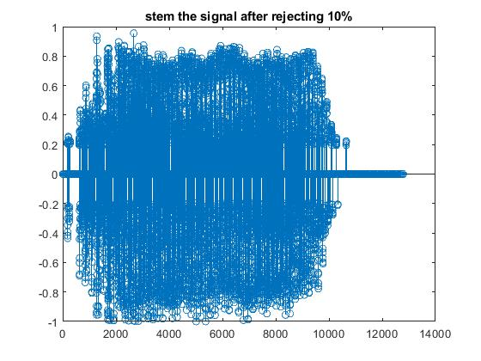
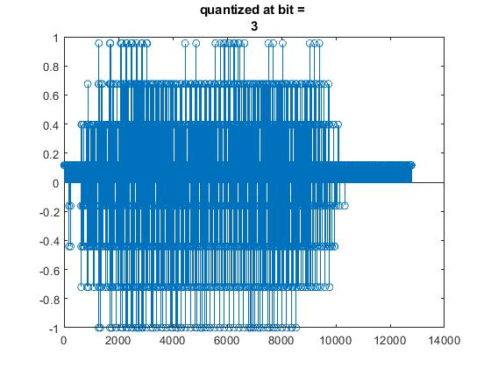
Findings
u can not be fraction, u is a non-linear non uniform method, which increases sample amplitude for certain lower amplitude, u law compression is not being helpful for particular purpose
Proposed method
To reject the silence part, we will reject the amplitude where we reject the 10% of the max value
Quantization
Sound is fine when it is quantized at bit 3

Slide 4
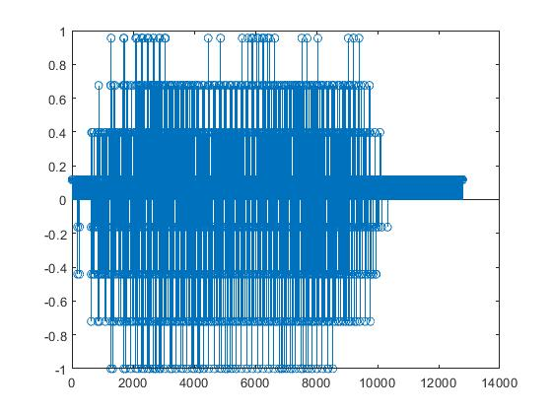
SQNR
SQNR in experiment: 11.575562159663557
SQNR in equation: 19.7600000000000
Encoded signal
Loose bit
Keeping the first bit is enough

